Slide 1
Biomedical Engineering
Divya Bhakta

Slide 2
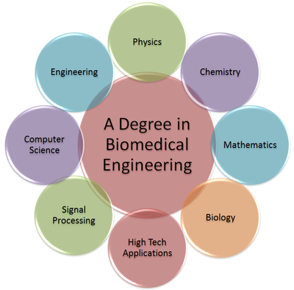
Education
Minimum requirement: Bachelors degree in Biomedical Engineering
Many different specializations:
Biomechanics
Bioinstrumentation
Cell tissue
Biomolecular engineering
Medical optics
Top 5 Schools:
Georgia Tech
Rice University
University of California-Irvine
Clemson University
University of Utah
Average Education Time: 4 years to complete Bachelors
Additional 1-2 years for Masters

Slide 3
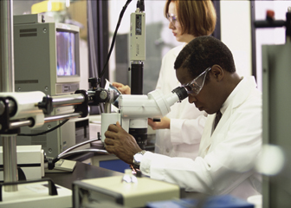
Training
Additional training needed (postemployment) to attain competency in the skills needed in this occupation.
Co-ops
Internships
Students will learn how to operate machinery and work with higher level engineers

Slide 4
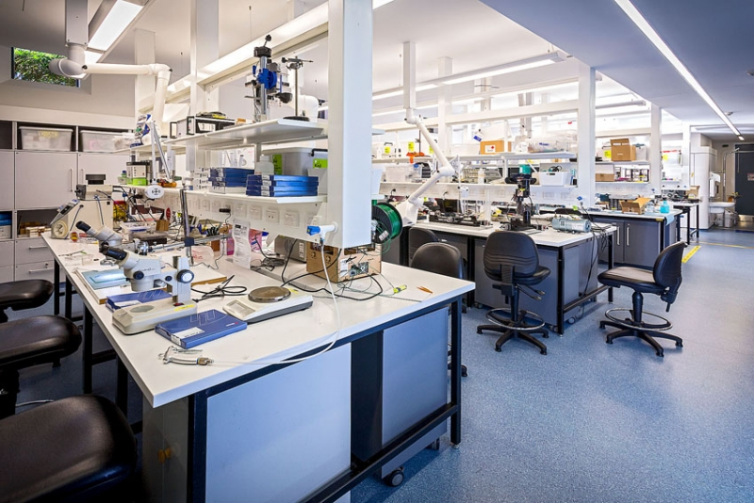
Job Location
Manufacturing
Universities
Research Facilities
Hospitals
Medical Institutions

Slide 5
Average Starting Salary
$53,800

Slide 6
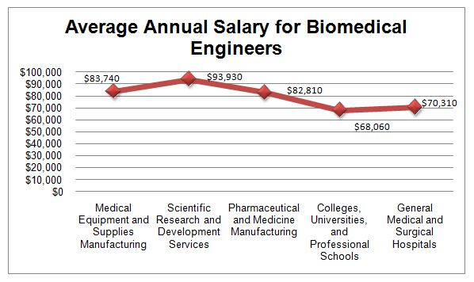
Average ten-year Salary
Salary grows an average of 82% to $97,800 by mid-career

Slide 7
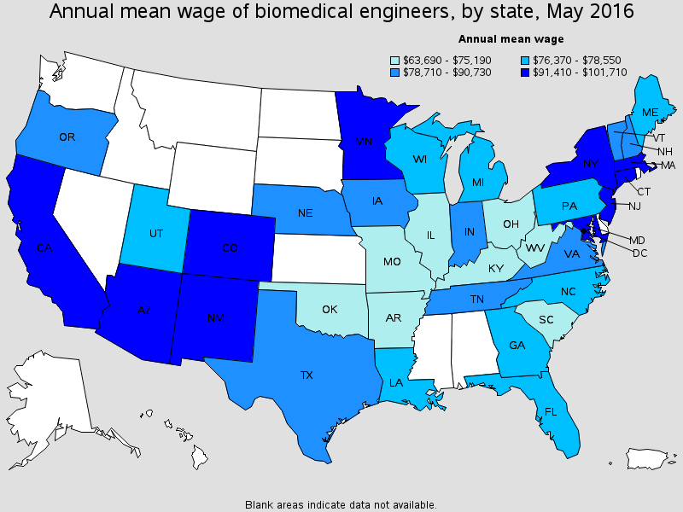
Areas of the Country
The highest paid biomedical engineers make the most in metropolitan areas
Anaheim, California
Tucson, Arizona
Taunton, Massachusetts

Slide 8
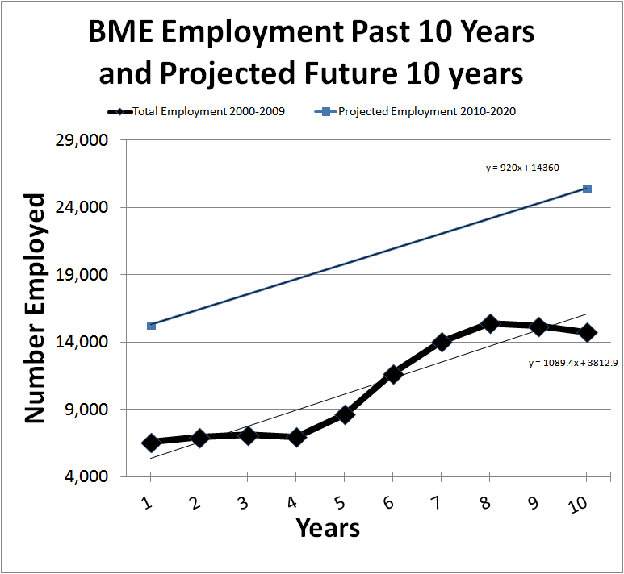
Outlook
Projected increase of 7 percent from 2016 to 2026
Biomedical engineers will see employment growth because of increasing possibilities brought by new technologies and increasing applications to medical equipment and devices

Slide 9
Turnover Rate
Around 15%

Slide 10
Working Conditions
Biomedical engineer may be exposed to disease, electric shock, radiation, burns and toxic fumes as part of the job
Overtime is not unusual, and hospital-employed engineers are often on-call. Those working in sales or performing field engineering may travel extensively.

Slide 11
Nature of Work
Design biomedical equipment and devices, such as artificial internal organs, replacements for body parts, and machines for diagnosing medical problems
Install, adjust, maintain, repair, or provide technical support for biomedical equipment
Research the engineering aspects of the biological systems of humans and animals with life scientists, chemists, and medical scientists
Prepare procedures, write technical reports, publish research papers, and make recommendations based on their research findings

Slide 12
Related Careers
Biochemists
Architectural Engineer
Chemical Engineer
Electrical Engineer
Sales Engineer

Slide 13
Interesting Facts
Biomedical engineering merges medicine and engineering to improve the quality of healthcare through innovative medical devices and processes
There are many different specializations within the biomedical field

Slide 14
Work Cited
https://www.bls.gov/ooh/architecture-and-engineering/biomedical-engineers.htm#tab-8
https://careertrend.com/dangers-risks-being-biomedical-engineer-32340.html
https://www.mtu.edu/biomedical/department/what-is/index.html

